Slide 1
Optimization of Specific Diesel Consumption in Joda East Iron Mines
(In Shovels, Dumpers and Loaders)
Guide-Mr. Amulya Swain (Senior Manager Mining)
1

Slide 2
Objectives of Project
Optimization of Diesel decreases the operating costs in Joda east iron mines
Decrease in fuel consumption can lead to the less pollution
Contributes to the more greener and sustainable future
2

Slide 3
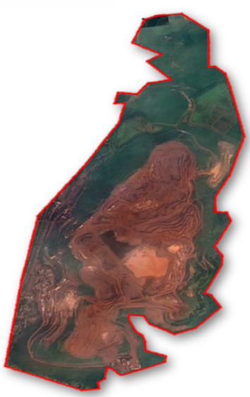
Overview of joda East Iron Mines
Total area of Joda East Iron Mines under TATA STEEL – 671.093 ha
Material type handled:
Dry ROM
Wet ROM
BHJ(Waste)
Subgrade
Hard Ore
i
Dumper
Total No . of Dumpers:- 15
Model :- KOMATSU HD 785
Shovel
Total No . of Shovel:- 5
Model :- Hitachi EX 1200
The average diesel consumption per tonnage production is 0.32 ltrs/ton
Loader
Total No . of Loader:- 2
Model:- KOMATSU WA 900-3E0
3

Slide 4
Operations of Dumper , Loader and SHovel
Dumper:-
The main operations of dumper are for transporting of material present from excavation point to processing plant or dumping area
In general dumpers consume 35-40 % of total diesel used .
Loader and shovel:-
The main operations of loader and shovel include the excavation of the material ,loading the dumper
In general loader consume 10-15% of total diesel used.
Shovel consumes 30-35% of total diesel used.
4

Slide 5
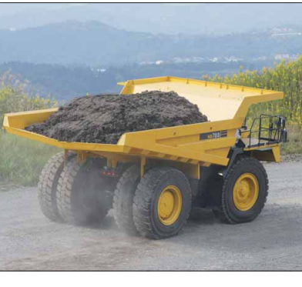
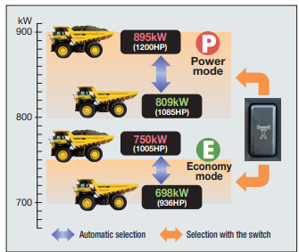
DuMper
Features
1.High Perfomance with advanced inbuilt technologies
2. Dual mode selection with variable horse power
Economy mode:- Lower level of fuel consumption
Power Mode:-For best production using maximum horse power
3. Inbuilt payload meters to analyze the load
4. Easy Maintenance, operator safety, High Reliability
Capacity
Struck Capacity :- 40 m3
Heaped :- 60m3
Rated payload :- 91.7 metric tons
Horse Power
Gross :- 895 KW 1200 HP
Net :- 879 KW 1178 HP
Rated GVW :- 163780 Kg
Fuel Capacity :- 1308 L
5

Slide 6
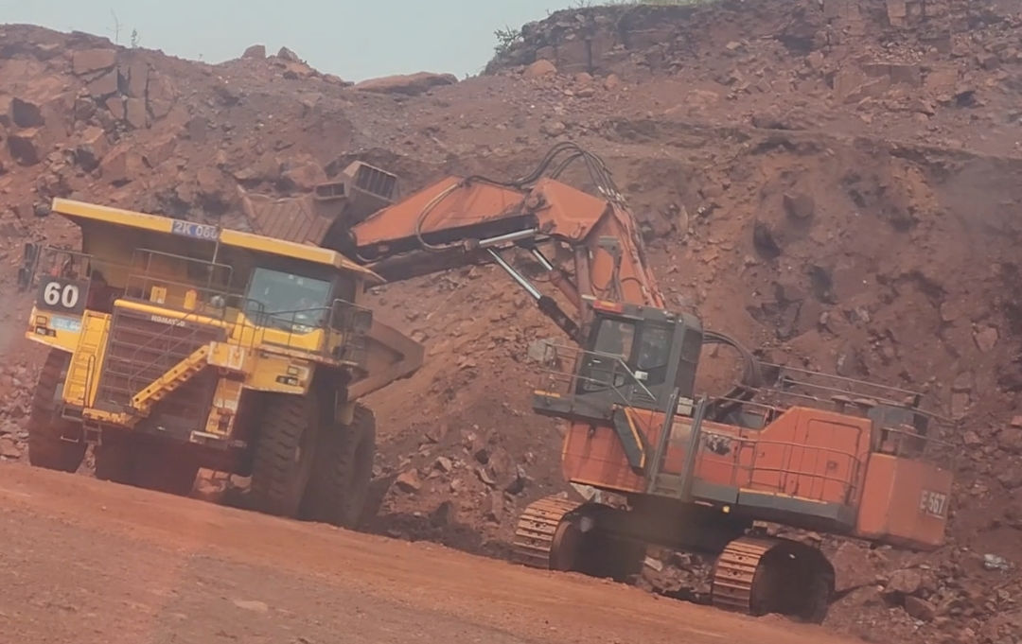
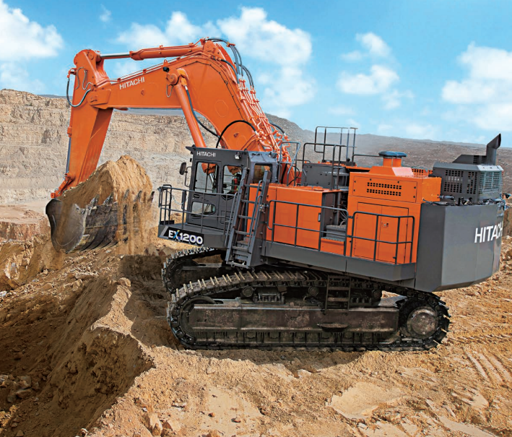
Shovel
Details of shovel:-
Capacity of shovel:- 5.9 m3
Fuel tank capacity:- 1700L
Maximum digging depth:-15ft 8 in
Maximum dumping height:- 28ft 8 in
To fill a dumper:-
Assuming in case of fines the fill factor 0.9
Bulk density= 2.8-3.5 assuming 3 as an average
Tonnage of material through each pass= bulk density* bucket fill factor* bucket capcity 5.9* 3* 0.9= 15.93 T
Number of passes required= 100/15.93=6.27= 6-7 passes are requried
Assuming in case of coarse material the fill factor 0.75
Bulk density= 2.8-3.5 assuming 3.2 as an average
Tonnage of material through each pass= bulk density* bucket fill factor* bucket capcity 5.9* 3.2* 0.75= 14.16 T
Number of passes required= 100/14.16=7.06= 7-8 passes are requried
Specially designed for fuel optimization
Has high productivity, durability and safety through installed advanced techniques
Auto idle system reduces engine speed in neutral mode to reduce fuel consumption
6

Slide 7
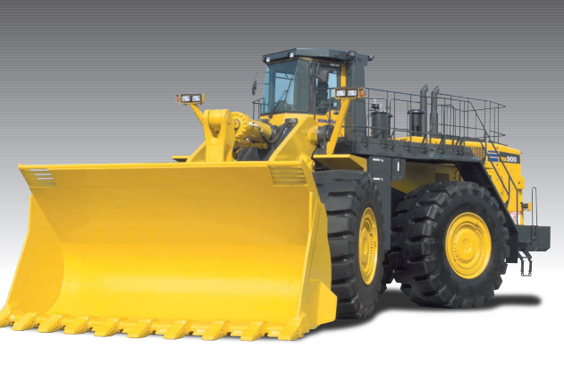
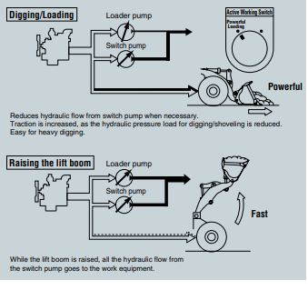
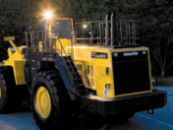
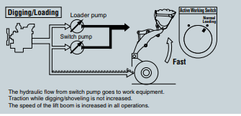
Loader
Dual Mode operating system:-
Bucket capacity of the loader:- 9m3
Horse power:- 638KW 856HP@2050 rpm
Fuel tank capacity:- 1555ltr
Currently we use two loaders of same model
Powerful loading
Features of Loader:-
High Productivity and Low fuel consumption:- Achieved by low noise , high torque and large capacity, Torque convertor with maximum efficiency.
Maximum breakout force
Large Clearance for dump truck Matching
Easy Maintenance
VHMS[Vehicle health monitoring system]
Operator Friendly environment
Normal loading
7

Slide 8
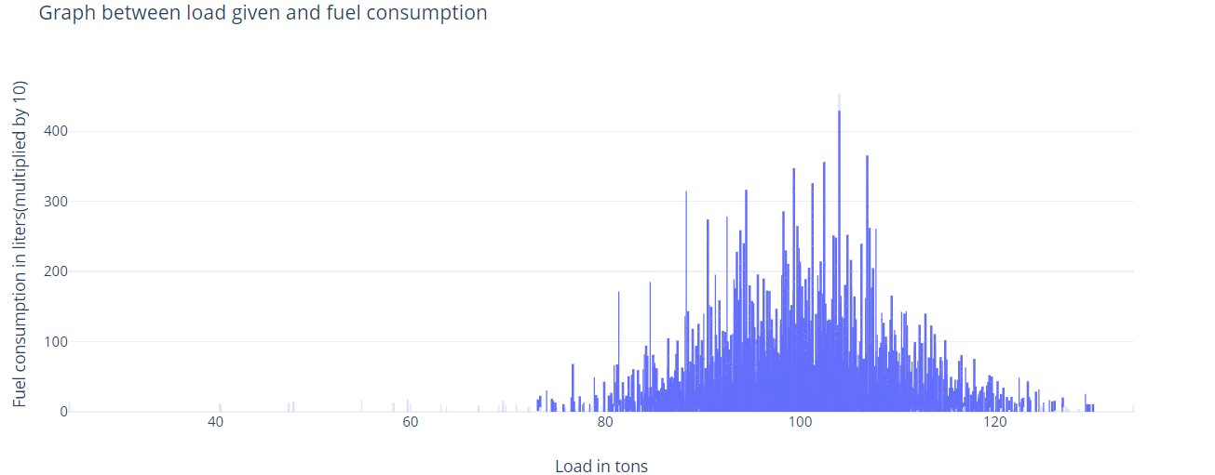
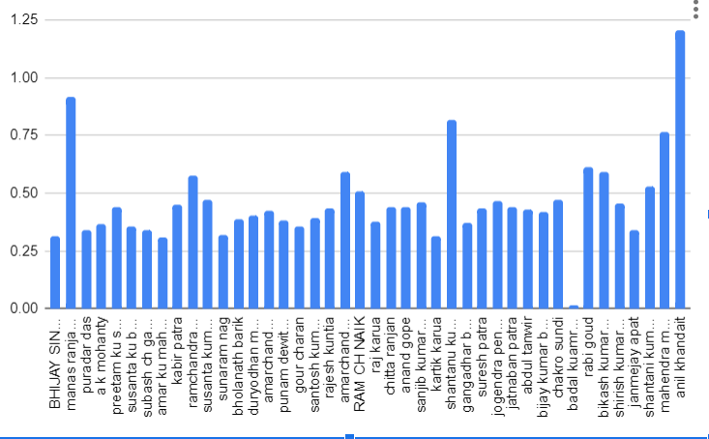
Plots showing the diesel consumption with various factors
The graph shows the relation between load given and fuel consumption in liters
The variance according to the load is 0.016 lt/tn for above 92.5 Tn
performance between fuel consumption(L/ton.km) and operator
The graph shows that operator performance also effects the diesel consumption based on his driving style and speed at which he is operating the vehicle, the way he is using the breaks , the mode he is using while travelling uphill with the load .
The mode set by operator during the idle time of vehicle also effects the diesel consumption of dumper.
8

Slide 9
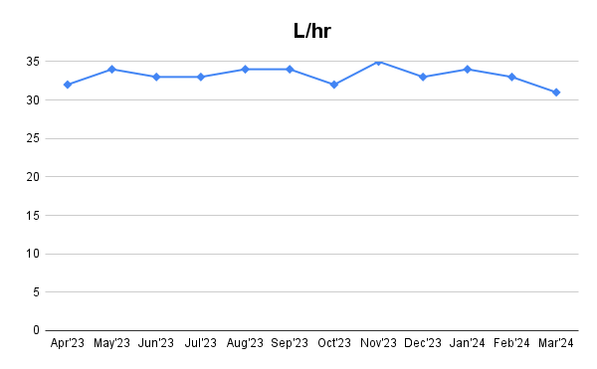
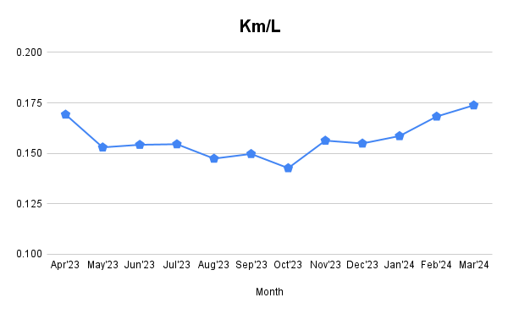
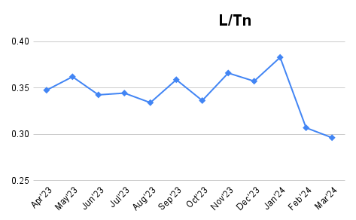
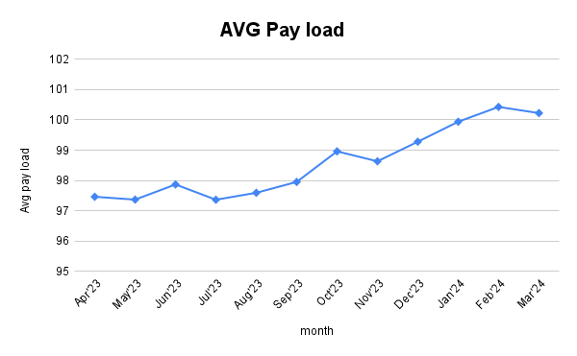
9

Slide 10
Analysis of Dumper Cycle time
In the total fraction of time the maximum amount of time is consumed during the dumper at idle time as Empty time , Empty stop time which constitutes to the 47% of total cycle time
Loading time and Hauling time are other factors where second majority of fraction of Time which constitutes to the 40% of the total cycle time
Waiting time at the dump is the another major factor for total cycle time , i.e, nearly 8%
10

Slide 11
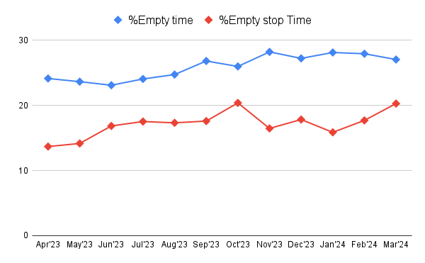
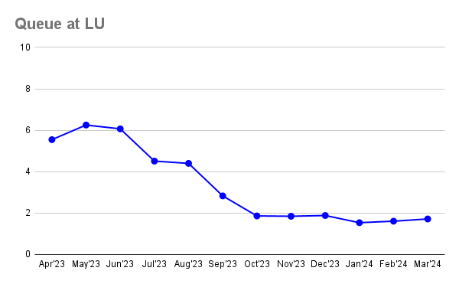
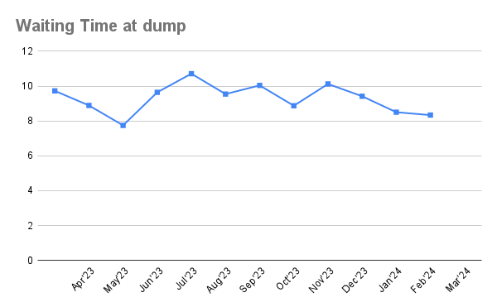
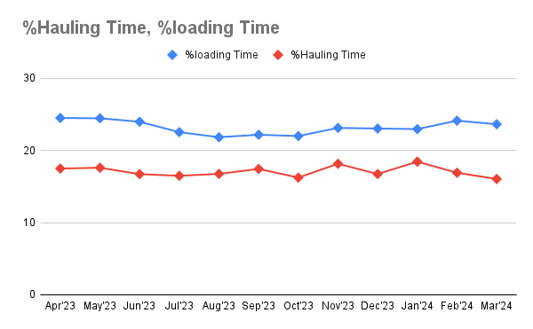
11

Slide 12
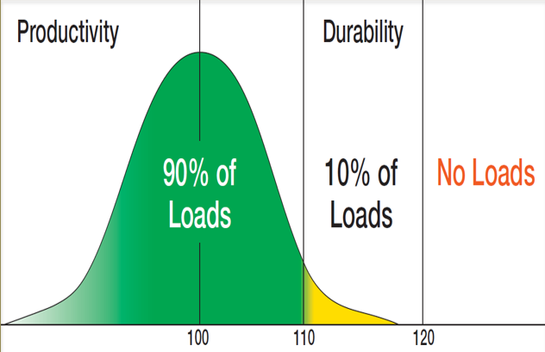
As per the OEM’s loading policy
90% of all loads must be below 110% (101.75tn) of the target payload of the truck.
10% of all loads must be between 110% and 120% of the target payload of the truck.
Any single load must not exceed 120% (110tn) of the target payload of the truck.
The load range below 110% should be around 90% but analysis shows that the load is 63.83%
For range 110-120% it should be 10% but it is 29.08%
No load should not be greater than 120% but here it is 7.114%
Ideal load should be 92.5 tn but 22.95% are underloaded with average 86.9tn
12

Slide 13
Diesel Consumption is high during:-
In case of dumpers:-
The fuel consumed is mainly effected by the
Hauling distance
Haul road conditions( Up hill and Down hill)[Such as gradient of the Haul road]
Idle conditions
Efficiency of the operator
Pay Load given at loading point
6. Total cycle time
13

Slide 14
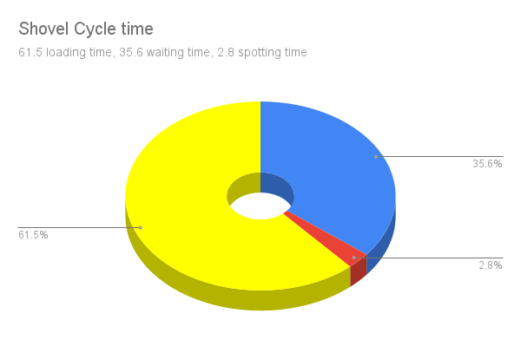
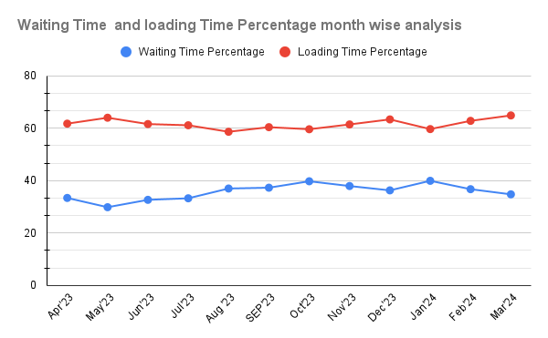
Shovel cycle Time analysis
The pie diagram showing the average cycle Time of shovel
Loading Time:- 61.5%
Waiting Time:- 35.6%
Spotting Time:-2.8%
The graph shows the analysis of the month wise waiting Time percentage and loading Time percentage in shovel
14

Slide 15
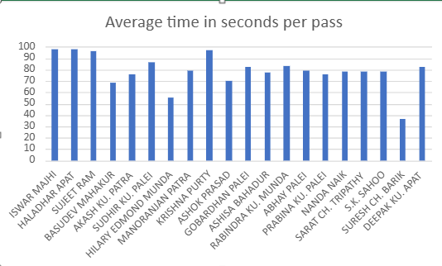
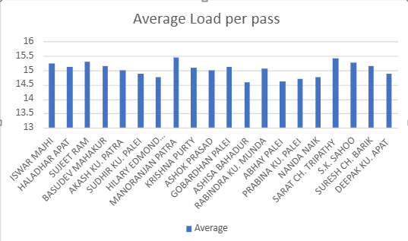
The operator efficiency is also another factor which effects the diesel consumption, because it effects the amount of material filled into the bucket and time taken to fill the bucket (Material per pass and Time per pass)
The average time per pass is 80 seconds but shown few operators take loading time per pass more than avg time
The average load per pass is about 15.02 Ton, seen that the operators are having the less operator efficiency
15

Slide 16
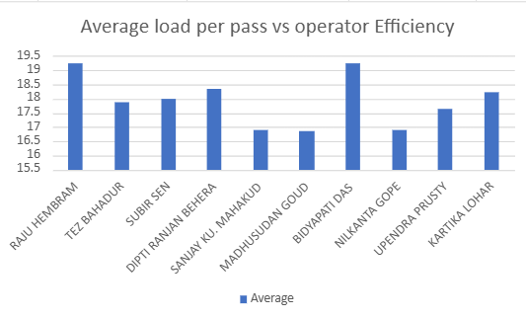
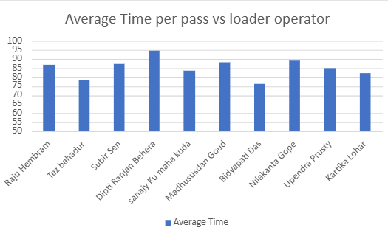
In case of loaders the diesel consumption also depends on the operator efficiency
Average load of the loader is 17.91 Ton , it shows that 50% operators are operating in less than average load required for pass
The average time taken by the operator to fill a loaded pass is 85.23 seconds
16

Slide 17
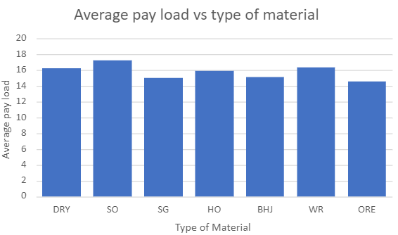
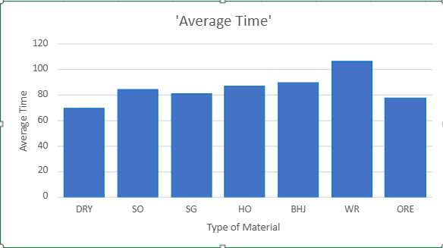
The diesel consumption of shovel depends on total cycle time which depends on the type of material being handled because it effects the factors such as average pay load per pass and average time taken per pass and also fill factor of the bucket
17

Slide 18
In case of shovels and loaders:-
1. The total Cycle time has loading time and waiting time as main components
(Loading time has more effect on the consumption of diesel by shovel)
2. Fuel consumption in shovel merely depends on the bucket fill factor(0.2%)
3. The operational skills also effects the consumption of diesel.(5-15%)
4. The fragmentation size also effects the entire operation(Depends on the type of material)
5. Condition of shovel in idling time is also another factor effects diesel consumption
18

Slide 19
Problem: Variability in operator efficiency observed among the operators, such as using different modes while travelling, loading ,unloading, speed
Enhance operator efficiency through targeted training and continuous feedback of the operators
Ensure that operators get analysis of their operating skills in the feedback form weekly
Setting up the instructions to follow, eg: to use which modes for decreasing the fuel consumption
Result: Enhancing operator efficiency through training and technology optimizes fuel consumption, achieving both operational excellence and environmental sustainability.
From studies, showing that operator efficiency can reduce 5-15% of fuel consumption , and has 20% effect on fuel consumption
19

Slide 20
Recommendations
Problem: Pay load given to the dumpers are varying much and 23% of dumpers seen in underloaded condition
Ensure that all the dumpers are at least given payload 92.5tn
Integrating sensors with both dumpers and shovels which gives alert when load is exceeding 110% of 92.5tn
Alerting operators if load is not given properly, which also sends response to the FMS
Result: Decreasing variability in payload ensures to increase productivity , decreases wear and tear of HEMM, Fuel consumption can be saved without overload and underload of loaders
The reducing of pay load variance can save 5-10% of the fuel consumption and has 15% effect on fuel consumption
20

Slide 21
Problem: Waiting time of shovel is around 35% and idle time of dumpers is around 40% ,waiting time at the dump is around 8%.
The dynamic allocation of the dumper to the loader or shovel should be used
Proper traffic management of the dumper near dumping plant or dumping location to be maintained in order to decrease the overall waiting time
Result: As a result of increasing the run time , productivity increases and idle time reduces that reduces the total cycle time.
The dynamic allocation of the dumper to the excavators ensures in decrease of waiting time and ideal time of both the dumper and shovel by 10-30%
The overall decrease in the cycle time reduces the fuel consumption by 5-15%
21

Slide 22
For Financial Year ’25( COSt Analysis)
Total Fuel Consumption=61,89,241.6 lt
By implementing all the recommendations we can save around 5-8% of total fuel consumed
Total fuel that can be saved=3,09,462.08-4,95,139.33 lt,
Average fuel that can be saved= 4,02,300.7lt
The operating costs can be decreased by 3,78,64,542/- annually
CO2 emissions:-
Per litre of diesel 2.7 kg of CO2 is emitted
We can decrease CO2 emission by 10,86,211.9kg annually

Slide 23
Thank you

